Slide 1
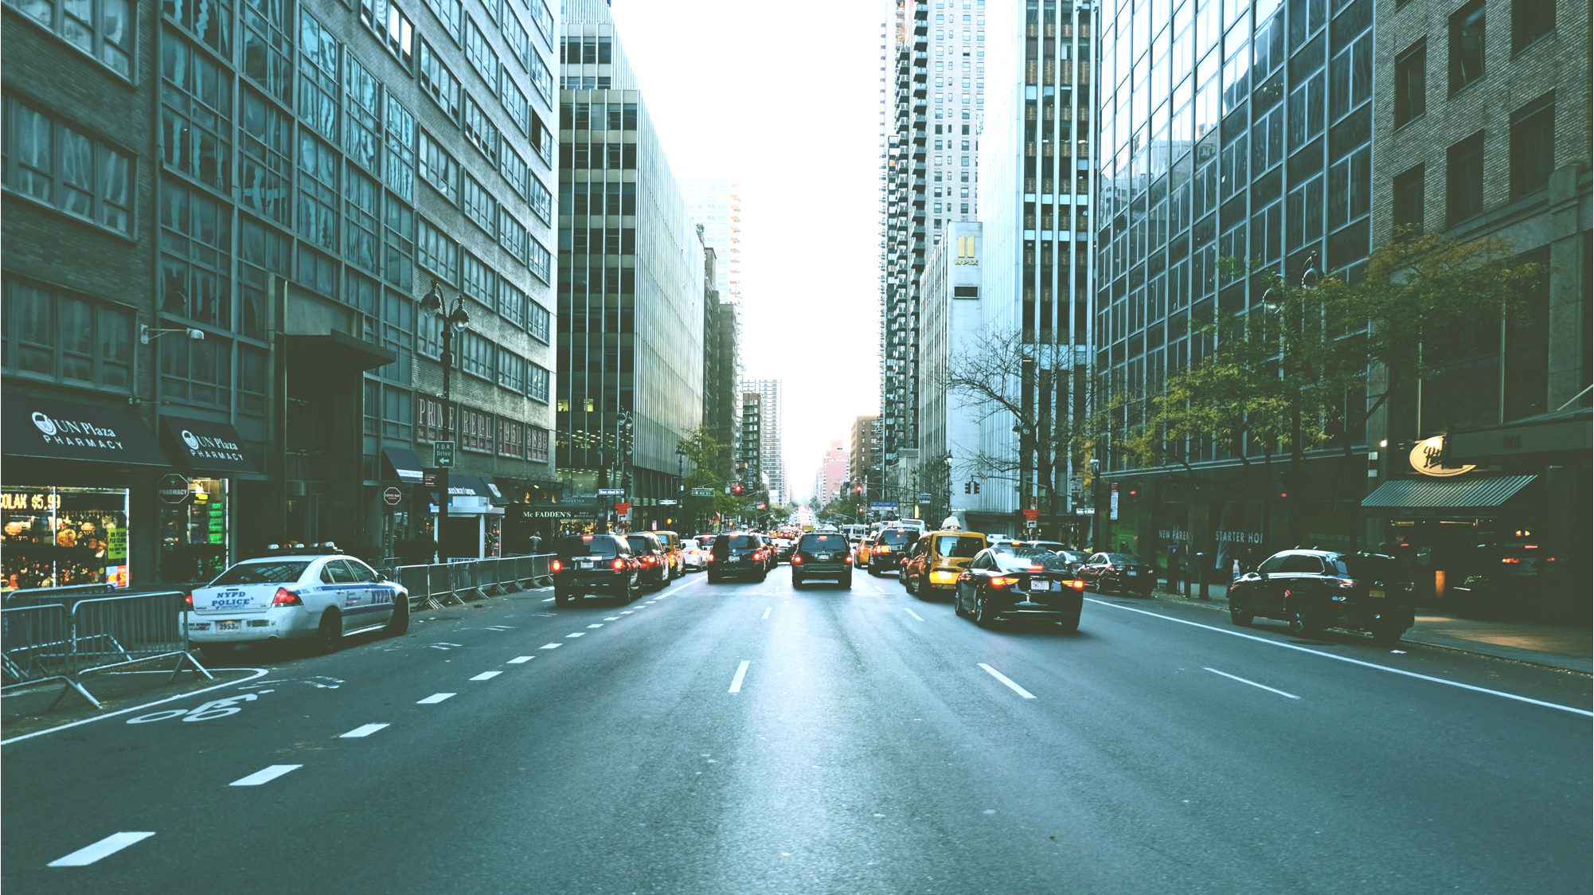
Ch. 10
MARKET FAILURE
Lecture Slides Presented by Dr. Edward C. Hoy
Notes:
These slides contain content from “Chapter 10: Market Failure” and includes supplementary material intended for class discussions and additional real world examples.

Slide 2

MARKET FAILURES & LIMITATIONS OF FREE MARKETS
CHAPTER 10
GOALS
Understand Market Structures
Market failures resulting from “free markets.”
Different ways government can potentially correct market failures.
KENNESAW STATE UNIVERSITY | COLES COLLEGE OF BUSINESS

Slide 3


MARKET FAILURES & LIMITATIONS OF FREE MARKETS
FREE MARKETS
Remember: “free market” outcomes are often efficient...
FYI: “Free” markets generally refer to minimal government intervention
KENNESAW STATE UNIVERSITY | COLES COLLEGE OF BUSINESS
Notes:
Again, we must define what we mean when we say “free” markets. “Free” markets generally refer to markets that are minimally regulated by government (since examples of perfectly free markets are exceedingly rare in today’s world).
See the list of assumptions that must be met for a market to be perfectly efficient on slide 9 (topic: perfect competition).

Slide 4
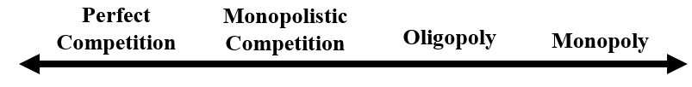
MARKET FAILURES & LIMITATIONS OF FREE MARKETS
FOUR MARKET STRUCTURES
(Key Difference: level of market power granted to the firm)
Seller with market power has some control over the price of its output, as it:
loses some (but not all) customers if it slightly increases price, and;
(ii) must decrease price if it wants to increase quantity sold.
NOTE: Sellers create some level of market power through product differentiation.
KENNESAW STATE UNIVERSITY | COLES COLLEGE OF BUSINESS
Notes:
Before discussing market failures, let’s discuss four types of market structures that exist in capitalist systems…
What is the key difference among various market types? The level of market power that a firm has over price in the market (see pg. 228 in the textbook).
A seller with market power has some control over the price of her output, in that she:
(i) will lose some (but not all) customers if she slightly increases price and
(ii) must decrease price if she wants to increase quantity sold.
For a seller to have some level of market power, all she needs is that consumers view her product as slightly different from that being sold by her competitors. This is called product differentiation.

Slide 5
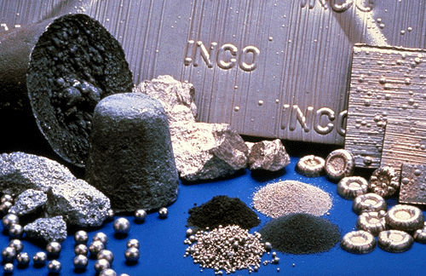
MARKET FAILURES & LIMITATIONS OF FREE MARKETS
BARRIERS TO ENTRY
(Constraints that protects a firm from would-be competitors)
1) Resource Ownership (e.g., Pre-WWII, the International Nickel Company of Canada (INCO) owned a significant percentage of the world’s nickel supply.
2) Natural Barriers (e.g., if a mkt has significant ‘economies of scale’ that has already been exploited by an existing firm, it is difficult for new entrants to crack the mkt)
3) Legal Protection (e.g., tariffs, quotas, embargoes, subsidies, patent, copyrights.)
KENNESAW STATE UNIVERSITY | COLES COLLEGE OF BUSINESS

Slide 6

MARKET FAILURES & LIMITATIONS OF FREE MARKETS
Perfect
Competition
KENNESAW STATE UNIVERSITY | COLES COLLEGE OF BUSINESS

Slide 7
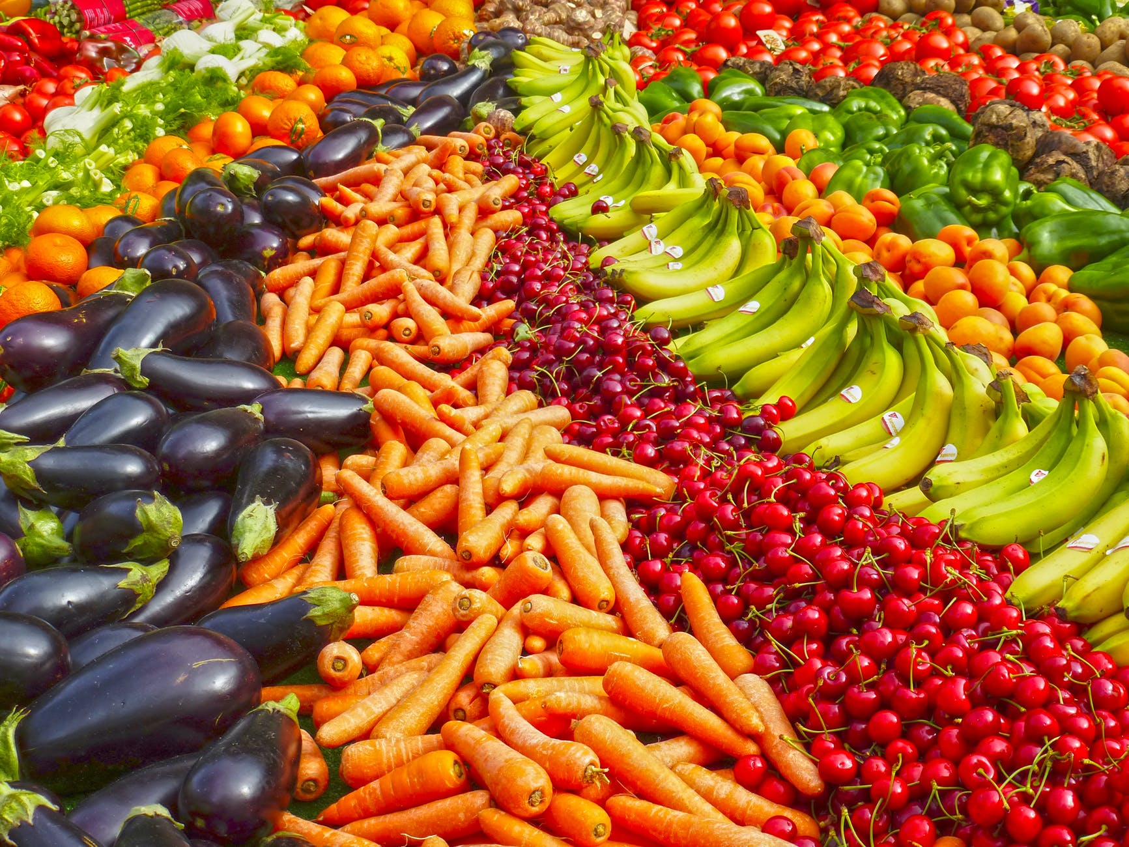
MARKET FAILURES & LIMITATIONS OF FREE MARKETS
‘Agricultural’ market comes comes closest to a perfectly perfectly competitive market.
KENNESAW STATE UNIVERSITY | COLES COLLEGE OF BUSINESS

Slide 8
MARKET FAILURES & LIMITATIONS OF FREE MARKETS
Requirements of Perfect Competition:
Number: Many buyers & sellers.
Barrier to entry: Very low: (enter when market is profitable, exit when its unprofitable).
Types of Substitutes: Very good: (identical/homogenous/standardized product).
Information. Buyers know the nature and prices of the product.
Pricing Power: none. Firms are price-takers.
Basis of Competition: Price only.
Profits. Firms aim is to maximize it.
Market share. Relatively small.
KENNESAW STATE UNIVERSITY | COLES COLLEGE OF BUSINESS

Slide 9
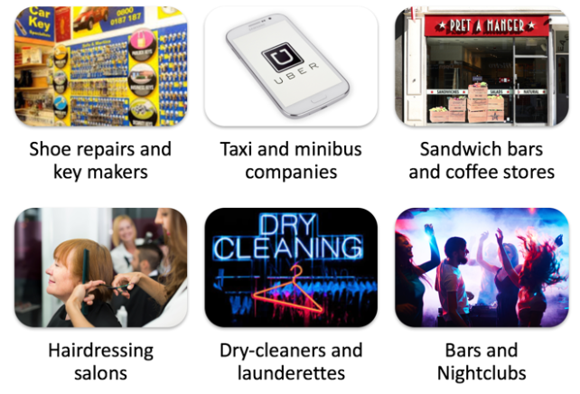
MARKET FAILURES & LIMITATIONS OF FREE MARKETS
MONOPOLISTIC
COMPETITION

Slide 10
MARKET FAILURES & LIMITATIONS OF FREE MARKETS
Requirements of Monopolistic Competition:
Number: Many buyers & sellers; same as PC.
Barrier to entry: low vs. very low for PC.
Pricing Power: little vs. none for PC.
Information. Firms are selling similar, yet distinct products, so firms determine the pricing (price makers).
Types of Substitutes: Differentiated: (heavy advertising with an aim to build customer loyalty).
Basis of Competition: Marketing, quality, & price vs. Price only for PC.
Profits. Firms aim to maximize it.
Market share. Some degree of market control vs. relatively small for PC.
KENNESAW STATE UNIVERSITY | COLES COLLEGE OF BUSINESS

Slide 11
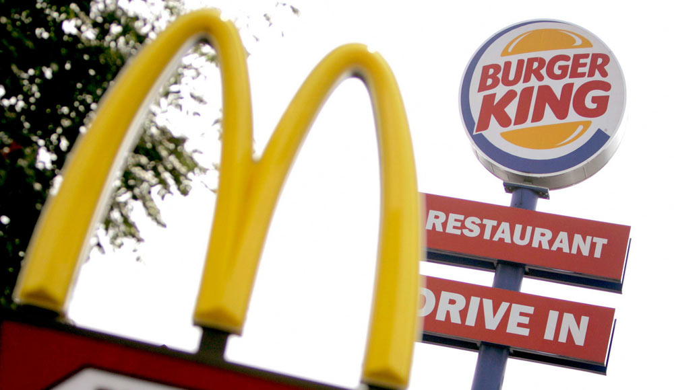
MARKET FAILURES & LIMITATIONS OF FREE MARKETS
DIFFERENTIATION
Similar
Little difference between competitors:
Buns (water, wheat, yeast)
Beef patty (cow meat)
Ingredients (Mayo, lettuce, etc.)
Different
Competitors advertise
quality,
freshness;
grilled v. gridle
distinctive package
special service—e.g., money-back guarantee, etc.
KENNESAW STATE UNIVERSITY | COLES COLLEGE OF BUSINESS

Slide 12
MARKET FAILURES & LIMITATIONS OF FREE MARKETS
It is more difficult to analyze a monopolistically competitive market than a perfectly competitive market because in a monopolistically competitive market A. products are differentiated, which results in nonprice competition. B. a normal profit in the long run is normal. C. there is only one firm. D. firms are characterized by mutual interdependence
ANSWER: A
KENNESAW STATE UNIVERSITY | COLES COLLEGE OF BUSINESS

Slide 13
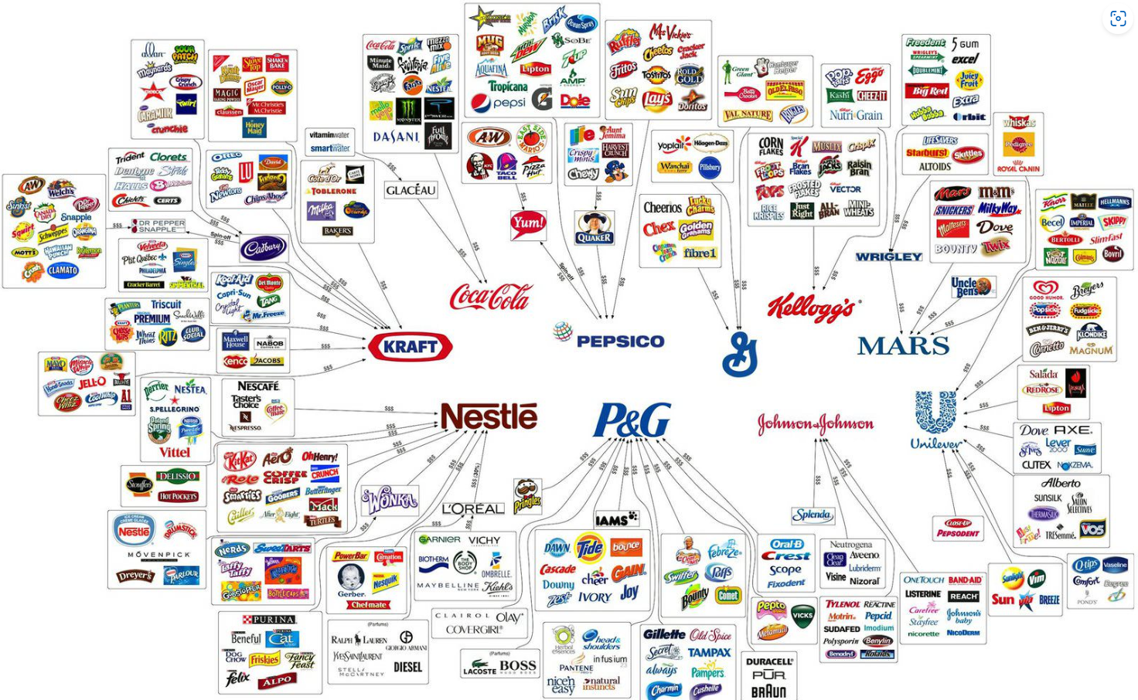
MARKET FAILURES & LIMITATIONS OF FREE MARKETS
O
L
I
G
O
P
O
L
Y
KENNESAW STATE UNIVERSITY | COLES COLLEGE OF BUSINESS

Slide 14




MARKET FAILURES & LIMITATIONS OF FREE MARKETS
CELL PHONE PROVIDERS
KENNESAW STATE UNIVERSITY | COLES COLLEGE OF BUSINESS

Slide 15


MARKET FAILURES & LIMITATIONS OF FREE MARKETS
U.S. AUTOMOBILE MANUFACTURES
KENNESAW STATE UNIVERSITY | COLES COLLEGE OF BUSINESS

Slide 16






MARKET FAILURES & LIMITATIONS OF FREE MARKETS
MEDIA
KENNESAW STATE UNIVERSITY | COLES COLLEGE OF BUSINESS

Slide 17
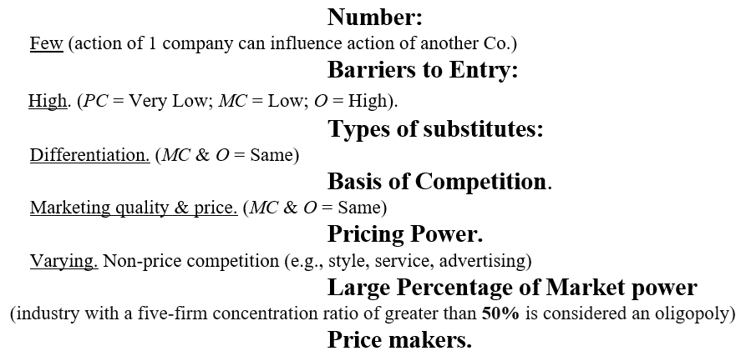
MARKET FAILURES & LIMITATIONS OF FREE MARKETS
Requirements of OLIGOPOLY
KENNESAW STATE UNIVERSITY | COLES COLLEGE OF BUSINESS

Slide 18
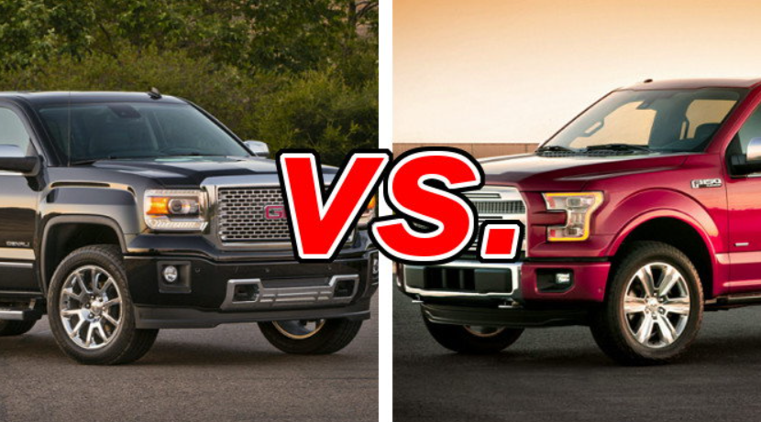
MARKET FAILURES & LIMITATIONS OF FREE MARKETS
‘DIFFERENTIATION’ in OLIGOPOLY
Competing brands
Almost homogenous,
Typically engage in considerable ‘nonprice competition,’
NPC is supported by ‘heavy advertising’ to maintain or win over new customers.
How so? Stressing differences in:
new car pricing,
depreciation,
horsepower,
fuel efficiency,
towing capacity,
reliability,
GMC Sierra
F-150
KENNESAW STATE UNIVERSITY | COLES COLLEGE OF BUSINESS

Slide 19
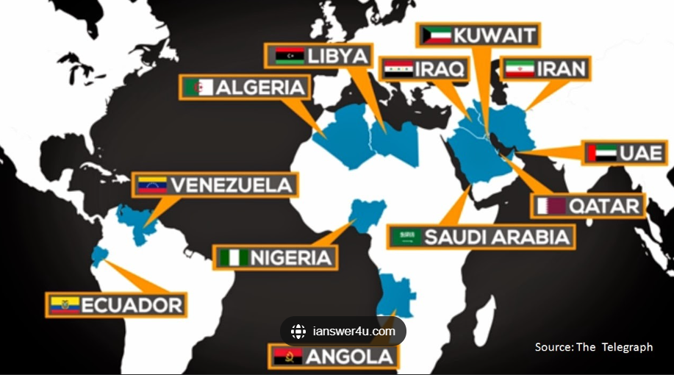
MARKET FAILURES & LIMITATIONS OF FREE MARKETS
CARTEL
A formal agreement among firms to coordinate prices and production (if illegal, it is known as collusion).
OPEC
KENNESAW STATE UNIVERSITY | COLES COLLEGE OF BUSINESS

Slide 20
MARKET FAILURES & LIMITATIONS OF FREE MARKETS
In monopolistically competitive markets, entry barriers
do not exist.
are more prevalent than in perfectly competitive markets but less than in monopoly markets.
are more prevalent than in monopoly markets but less than in perfectly competitive markets.
are blocked.
ANSWER b)
KENNESAW STATE UNIVERSITY | COLES COLLEGE OF BUSINESS

Slide 21
MARKET FAILURES & LIMITATIONS OF FREE MARKETS
Which one of the following is a factor used to distinguish between different market structures? A The degree of product differentiation B The number of employees C The degree of efficiency D The sector of industry
ANSWER: A
KENNESAW STATE UNIVERSITY | COLES COLLEGE OF BUSINESS

Slide 22

MARKET FAILURES & LIMITATIONS OF FREE MARKETS
KENNESAW STATE UNIVERSITY | COLES COLLEGE OF BUSINESS
Notes:
Examples of different types of legal monopolies.

Slide 23

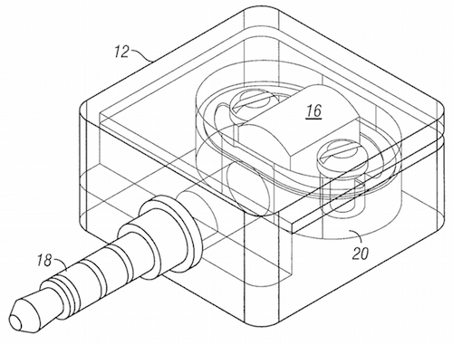

MARKET FAILURES & LIMITATIONS OF FREE MARKETS
LEGAL MONOPOLIES
PATENT/
COPYRIGHT
GOVERNMENT
LICENSE
PUBLIC
FRANCHISE
KENNESAW STATE UNIVERSITY | COLES COLLEGE OF BUSINESS
Notes:
Examples of different types of legal monopolies.

Slide 24
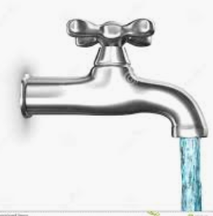
MARKET FAILURES & LIMITATIONS OF FREE MARKETS
LEGAL MONOPOLY(cont.)
Providers of Public Utilities:
water,
natural gas,
telecommunications,
electricity
Legal monopoly have exclusive rights to service municipalities through local govt.
These monopolies are regulated in part by the state.
KENNESAW STATE UNIVERSITY | COLES COLLEGE OF BUSINESS

Slide 25
MARKET FAILURES & LIMITATIONS OF FREE MARKETS
Requirements of MONOPOLY
Number:
One. (One seller with large number of buyers.)
Barriers to Entry:
Very High. (PC=Very Low; MC=Low; O=High; M=Very high).
Types of Substitutes:
None. (Unique product; no close substitutes offered in the market.)
Basis of Competition.
Advertising alone. (e.g., Public awareness)
Pricing Power
Significant
Price maker/setter.
FYI: Many monopolies are government licensed or franchised
KENNESAW STATE UNIVERSITY | COLES COLLEGE OF BUSINESS

Slide 26
MARKET FAILURES & LIMITATIONS OF FREE MARKETS
SINGLE-PRICE MONOPOLY
A firm must sell each unit of its output for the same price to ALL its customers –
(i.e., the firm is unable to price discriminate.)
KENNESAW STATE UNIVERSITY | COLES COLLEGE OF BUSINESS
Notes:
Let’s discuss the case of the single-price monopoly.

Slide 27
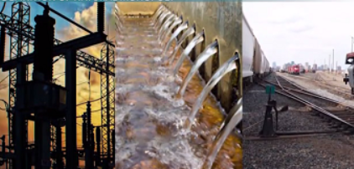
MARKET FAILURES & LIMITATIONS OF FREE MARKETS
NATURAL MONOPOLY
Market in which economies of scale allow ONE firm to supply a product at a lower per-unit cost than several firms.
Railroads, electrical power, water/utilities and railroads
KENNESAW STATE UNIVERSITY | COLES COLLEGE OF BUSINESS

Slide 28
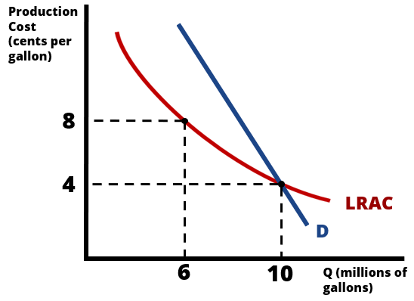
MARKET FAILURES & LIMITATIONS OF FREE MARKETS
Natural Monopoly
Economies of scale allow …
One efficient firm to produce 10m units of output at 4 cents p/g (more efficient).
(vs)
Multiple water firms that produce only 6m units, at a higher price of 8 cents p/g (less efficient).
KENNESAW STATE UNIVERSITY | COLES COLLEGE OF BUSINESS
Notes:
Imagine a water municipality that is more efficient at supplying the city’s water than if there existed multiple water companies attempting to supply water to the same city.

Slide 29
MARKET FAILURES & LIMITATIONS OF FREE MARKETS
ECONOMIES OF SCALE
Why Does Economies of Scale Occur?
Firms employ more/better use of:
a) “Mass Production Techniques,” &;
b) “Specialization.”
Total Cost is HIGHER for a car company to produce 100,000 cars, than for a car company to produce 50 cars.
(—However—)
Employing mass production techniques/specialization allows a company producing 100,000 cars to achieve lower average cost (spaces out cost over large production) p/car, than a company producing 50,000 cars – ECONOMIES OF SCALE!
KENNESAW STATE UNIVERSITY | COLES COLLEGE OF BUSINESS

Slide 30
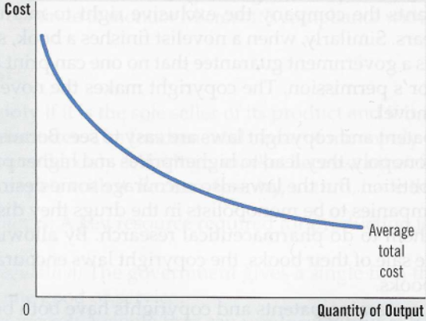
MARKET FAILURES & LIMITATIONS OF FREE MARKETS
ECONOMIES
OF
SCALE
When a firm’s average-total-cost curve continually declines, the firm is called a Natural Monopoly
KENNESAW STATE UNIVERSITY | COLES COLLEGE OF BUSINESS

Slide 31
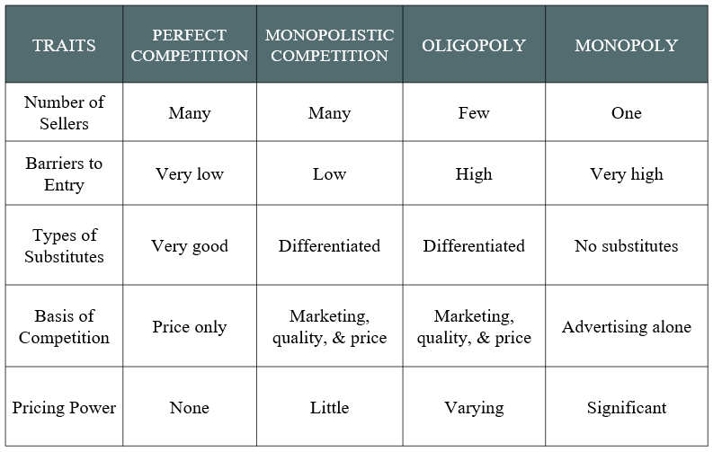

Slide 32
MARKET FAILURES & LIMITATIONS OF FREE MARKETS
Traditional methods of the theory of all market structures assume that the firm has the objective of
profit satisficing.
sales revenue maximization.
maximizing the quality of the output.
profit maximization.
ANSWER: D
KENNESAW STATE UNIVERSITY | COLES COLLEGE OF BUSINESS

Slide 33
MARKET FAILURES & LIMITATIONS OF FREE MARKETS
Which of the following market structures is (theoretically) perfectly efficient?
A. Perfect Competition
B. Monopolistic Competition
C. Oligopoly
D. Monopoly
KENNESAW STATE UNIVERSITY | COLES COLLEGE OF BUSINESS
Notes:
Answer: A

Slide 34
MARKET FAILURES & LIMITATIONS OF FREE MARKETS
A monopolistically competitive market is marked by:
B. A few sellers
A. Homogenous goods
D. A unique good
C. Differentiated goods
KENNESAW STATE UNIVERSITY | COLES COLLEGE OF BUSINESS
Notes:
Answer: C

Slide 35

MARKET FAILURES & LIMITATIONS OF FREE MARKETS
A. Homogenous goods
D. A unique good
C. Differentiated goods
KENNESAW STATE UNIVERSITY | COLES COLLEGE OF BUSINESS

Slide 36
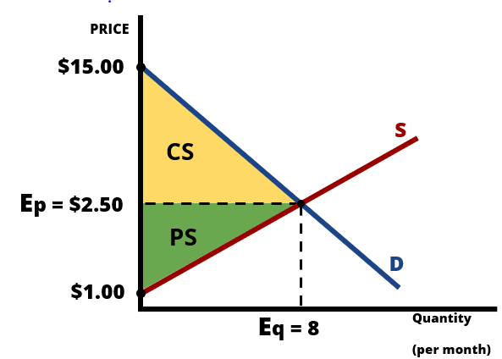
MARKET FAILURES & LIMITATIONS OF FREE MARKETS
Efficiency
This market is perfectly competitive and perfectly efficient
Recall that a market is considered efficient when total economic surplus (the sum of consumer surplus and producer surplus) is maximized.
KENNESAW STATE UNIVERSITY | COLES COLLEGE OF BUSINESS
Notes:
Recall that a market is considered efficient when total economic surplus (the sum of consumer surplus and producer surplus) is maximized.

Slide 37
MARKET FAILURES & LIMITATIONS OF FREE MARKETS
What happens when the assumptions of “perfect competition” are broken?
Market Failure emerges
“Negative Externality” free market provides “too much” of a bad thing (e.g., air pollution.)
“Positive Externality” free market provides “too little” of a good thing (e.g., vaccines.)
(We shall graph these in a moment)
KENNESAW STATE UNIVERSITY | COLES COLLEGE OF BUSINESS

Slide 38
MARKET FAILURES & LIMITATIONS OF FREE MARKETS
Market failure often provide the strongest case for government intervention
(but)
Intervention does not guarantee improvement of the situation.
KENNESAW STATE UNIVERSITY | COLES COLLEGE OF BUSINESS

Slide 39
MARKET FAILURES & LIMITATIONS OF FREE MARKETS
FIVE COMMON SOURCES OF MARKET FAILURE: (i.e., diminished total economic surplus).
Profit maximization by a firm with a lge. percentage (%) of mkt power.
Market provision of public goods.
Tragedy of the commons (e.g., depletion of non-renewable resources)
Market provision of goods that generate externalities.
Lack of information or asymmetric [unequal] info. in the market.
KENNESAW STATE UNIVERSITY | COLES COLLEGE OF BUSINESS
Notes:
Here is a list of common sources of market failures that diminish total economic surplus.

Slide 40
MARKET FAILURES & LIMITATIONS OF FREE MARKETS
“Market Failure” can be described as a situation in which …
a single seller of a good has substantial control over the price of the good.
the “free market outcome” is NOT efficient
government intervention leads to a greater Deadweight-Loss than does the “free market outcome.”
government imposes progressive taxes, in order to indirectly redistribute income.
Answer: B
KENNESAW STATE UNIVERSITY | COLES COLLEGE OF BUSINESS
Notes:
Here is a list of common sources of market failures that diminish total economic surplus.

Slide 41
MARKET FAILURES & LIMITATIONS OF FREE MARKETS
Which of the following is a common source of “Market Failure”?
Pricing by firms with market power.
Market provision of private goods.
Market provision of a good which generates an externality.
More than one (perhaps all) of the above answers are correct.
Answer: d
KENNESAW STATE UNIVERSITY | COLES COLLEGE OF BUSINESS
Notes:
Here is a list of common sources of market failures that diminish total economic surplus.

Slide 42
MARKET FAILURES & LIMITATIONS OF FREE MARKETS
Profit Maximization by a Firm may lead to Market Failure
Reminder: As with all competitive firms, the main goal of the monopoly is to maximize profit
Maximize Profit
= Total Revenue - Total Costs
Max($π$) = MR = MC
KENNESAW STATE UNIVERSITY | COLES COLLEGE OF BUSINESS

Slide 43
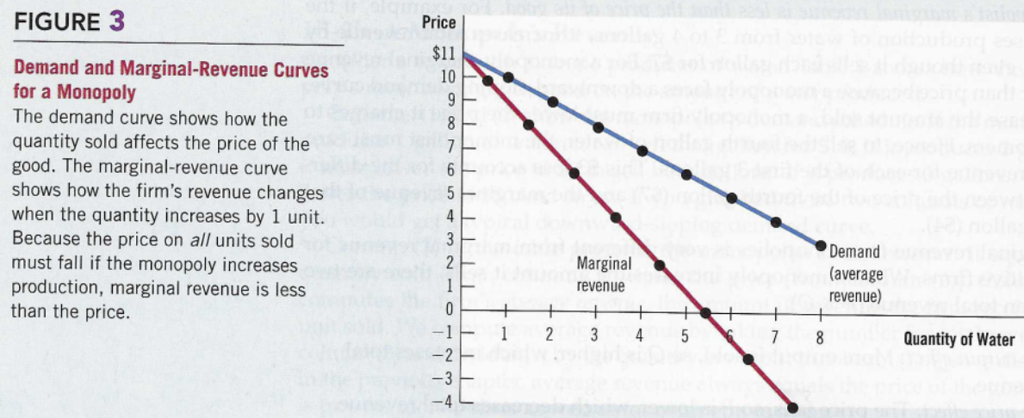
DEMAND (D) & MARGINAL REVENUE (MR) CURVES for a MONOPOLY
Downward Sloping Demand Curve
any decrease in price (P) will cause the quantity demanded (Q_{D}) to increase, & revenues to increase, vice-versa.
(P) * (Q) = (TR)
$10 * 1 = $10 $ 9 * 2 = $18
$ 8 * 3 = $24
Marginal-Revenue Curve
MR curve lies below its D curve.
Additional revenue gained (see table below) from selling an additional unit.
(P) * (Q) = (TR); Marginal Revenue (MR)
$10 * 1 = $10 $ 9 * 2 = $18 $8 (18-$10)
$ 8 * 3 = $24 $6 (24 - 18)

Slide 44
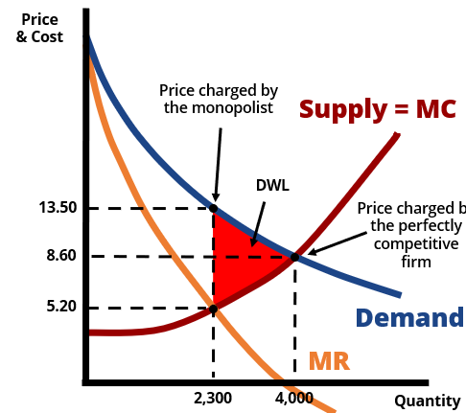
MARKET FAILURES & LIMITATIONS OF FREE MARKETS
Profit Maximization for a Monopoly
Monopoly maximizes profit by choosing the quantity (2,300) at which marginal revenue equals marginal cost (MR=MC).
Monopolies then seek the demand curve (D) to find the price ($13.50) that will induce consumers to buy that quantity.
Q: How is a monopoly different from a perfectly competitive firm?
A: Monopolist chooses to produce where MR=MC.
Perfect competition produces where S=D Result: Monopoly leads to lower quantities & higher price.
KENNESAW STATE UNIVERSITY | COLES COLLEGE OF BUSINESS

Slide 45
MARKET FAILURES & LIMITATIONS OF FREE MARKETS
SUMMARY OF MONOPOLIES
Monopolies produce at the profit maximizing output (i.e., MR = MC).
If MC > MR, the monopolist stops producing additional units.
Monopolies underproduce.
Unlike perfectly competitive markets, a monopoly charges a higher price due to being shielded from competition.
Monopoly markets result in a DWL.
KENNESAW STATE UNIVERSITY | COLES COLLEGE OF BUSINESS

Slide 46
MARKET FAILURES & LIMITATIONS OF FREE MARKETS
HOW DOES GOVERNMENT ATTEMPT TO REGULATE MONOPOLIES?
Antitrust Legislation (Sherman Antitrust Act)
Overseeing natural monopolies
Encouraging competition
KENNESAW STATE UNIVERSITY | COLES COLLEGE OF BUSINESS

Slide 47
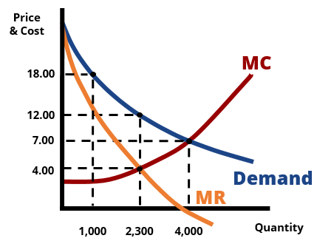
At what price/quantity pair will the monopolist choose to produce?
A. $18.00/1,000 units
B. $12.00/2,300 units
C. $7.00/4,000 units
D. $4.00/2,300 units
Notes:
Answer: B

Slide 48
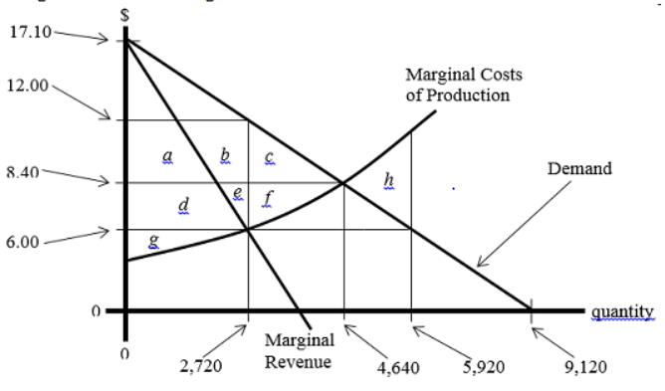
MARKET FAILURES & LIMITATIONS OF FREE MARKETS
The efficient level of output for this good is ____ units.
2,720
more than 2,720 but fewer than 4,640 units
4,640
9,120
KENNESAW STATE UNIVERSITY | COLES COLLEGE OF BUSINESS

Slide 49
MARKET FAILURES & LIMITATIONS OF FREE MARKETS
2. MARKET PROVISION OF PUBLIC GOODS
The provision of public goods _{e.g., public transportation} by the free market results in underproduction due to “rivalness” & “excludability”
in consumption.
KENNESAW STATE UNIVERSITY | COLES COLLEGE OF BUSINESS
Notes:
To understand this issue, we must first recognize that every good is characterized by a certain degree of “rivalness in consumption” and a certain degree of “excludability in consumption.”

Slide 50
MARKET FAILURES & LIMITATIONS OF FREE MARKETS
Which of the following policies could likely reduce “Deadweight-Loss” in the presence of a negative externality, such as pollution?
Establish minimum compliance standards for manufacturers in the industry (allowing them to generate only a certain amount of the negative externality).
Do nothing (i.e., just let the market allocate the good as is currently the case, with no deliberate government action whatsoever).
Offer subsidies to manufacturers for reducing the amount of the negative externality that they generate.
More than one (perhaps all) of the above answers is correct
ANSWER: d
KENNESAW STATE UNIVERSITY | COLES COLLEGE OF BUSINESS
Notes:
To understand this issue, we must first recognize that every good is characterized by a certain degree of “rivalness in consumption” and a certain degree of “excludability in consumption.”

Slide 51
MARKET FAILURES & LIMITATIONS OF FREE MARKETS
Excludability People ‘can’ be prevented from using a good. | Rivalry One person’s use of the good ‘diminishes’ another’s ability to use it.
Private goods Excludable & Rival in consumption ice cream cones, clothing, etc. | Public goods Non-excludable & Non-Rival Tornado siren, national defense, light house
Common resources Non-excludable but Rival in consumption Fish in the ocean; environmental abuse | Club goods Excludable & Non-rival Satellite radio/T.V., fire protection
KENNESAW STATE UNIVERSITY | COLES COLLEGE OF BUSINESS

Slide 52
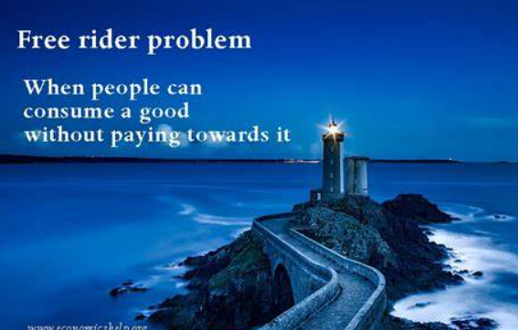
MARKET FAILURES & LIMITATIONS OF FREE MARKETS
Free Rider Problem
Public goods (e.g., light house) face a free-rider problem due to:
Non-rival: one person’s use of the light house does not reduce the amount available to others, and;
Non-excludable: difficult to prevent people from using the light house.
NOTE: If govt fails to supply a public good & the free-market does so instead, the amount traded would be less than the efficient quantity.
E.g., While Gates or Buffet may provide a “positive” number (e.g. public transportation) of public goods, the total amount would be “less than the efficient amount.”
KENNESAW STATE UNIVERSITY | COLES COLLEGE OF BUSINESS
Notes:
In the case of public goods provided by free markets, many people would attempt to enjoy the benefits derived from units purchased by others, while not purchasing any units of this good themselves.

Slide 53
MARKET FAILURES & LIMITATIONS OF FREE MARKETS
A “4th of July Fireworks displays in downtown Atlanta” is
easily “Excludable.”
perfectly “Rival in Consumption.”
very “Non-Rival in Consumption.”
More than one (perhaps all) of the above answers is correct.
Answer: c
KENNESAW STATE UNIVERSITY | COLES COLLEGE OF BUSINESS
Notes:
In the case of public goods provided by free markets, many people would attempt to enjoy the benefits derived from units purchased by others, while not purchasing any units of this good themselves.

Slide 54
MARKET FAILURES & LIMITATIONS OF FREE MARKETS
Jim lives in a country in which military output is not provided by the government, but rather is supplied by profit maximizing firms and purchased by individual consumers in a free market. Jim chooses to enjoy the benefits of national security which result from military output purchased by others in society, while purchasing “zero units of military output” of his own. This example illustrates …
Joseph Schumpeter’s account of a “gale of creative destruction.”
the Free Rider Problem.
the “Coasian Solution” to the problem of externalities.
Adam Smith’s “Invisible Hand.”
Answer: b
KENNESAW STATE UNIVERSITY | COLES COLLEGE OF BUSINESS
Notes:
In the case of public goods provided by free markets, many people would attempt to enjoy the benefits derived from units purchased by others, while not purchasing any units of this good themselves.

Slide 55
MARKET FAILURES & LIMITATIONS OF FREE MARKETS
On September 11, 2010, former heavyweight boxing champion Wladimir Klitschko defeated Samuel Peter by knockout in Frankfurt, Germany. This fight was only available in the U.S. on “Pay-Per-View.” The broadcast of this bout on “Pay-Per-View” is excludable but non-rival, and therefore referred to as a
Public Good.
Private Good.
Club Good.
Common Good.
ANSWER: c
KENNESAW STATE UNIVERSITY | COLES COLLEGE OF BUSINESS
Notes:
In the case of public goods provided by free markets, many people would attempt to enjoy the benefits derived from units purchased by others, while not purchasing any units of this good themselves.

Slide 56
MARKET FAILURES & LIMITATIONS OF FREE MARKETS
A good is “non-excludable” if …
consumption by one person does not diminish the quantity/quality of consumption by others.
consumption by one person does diminish the quantity/quality of consumption by others.
it is difficult (or very costly) to prevent consumption by those who do not pay for the good.
it is easy (or relatively costless) to prevent consumption by those who do not pay for the good.
ANSWER: c
KENNESAW STATE UNIVERSITY | COLES COLLEGE OF BUSINESS
Notes:
In the case of public goods provided by free markets, many people would attempt to enjoy the benefits derived from units purchased by others, while not purchasing any units of this good themselves.

Slide 57
MARKET FAILURES & LIMITATIONS OF FREE MARKETS
HOW TO “CORRECT” FOR THIS INEFFICIENCY?
Government Can Supply/Maintain Public Goods
Economic questions of (“what,” “how,” and “for whom”) are answered by the political process.
Taxes are imposed to cover the costs of production.
Not a guarantee of efficiency, rather, a safeguard against underproduction.
KENNESAW STATE UNIVERSITY | COLES COLLEGE OF BUSINESS

Slide 58
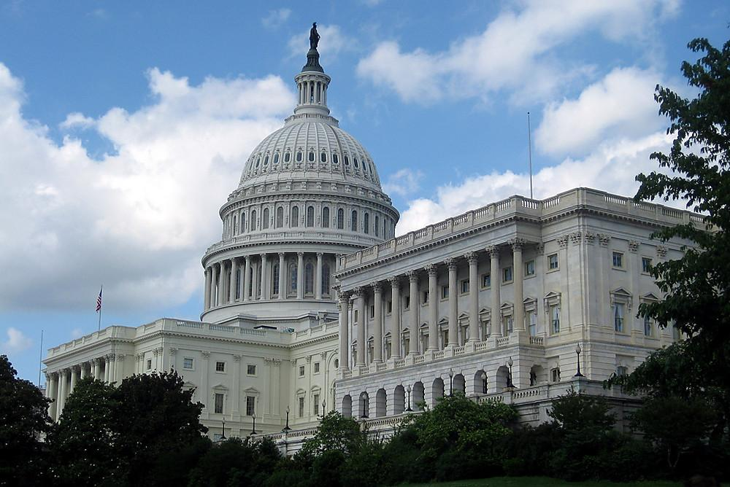
MARKET FAILURES & LIMITATIONS OF FREE MARKETS
POLICY IMPLICATIONS
Society should tax the actions it wants to discourage, and reduce taxes (subsidize)
for the actions it wants
to encourage.
KENNESAW STATE UNIVERSITY | COLES COLLEGE OF BUSINESS
Notes:
In the case of externalities, government must “internalize” the costs and benefits.

Slide 59
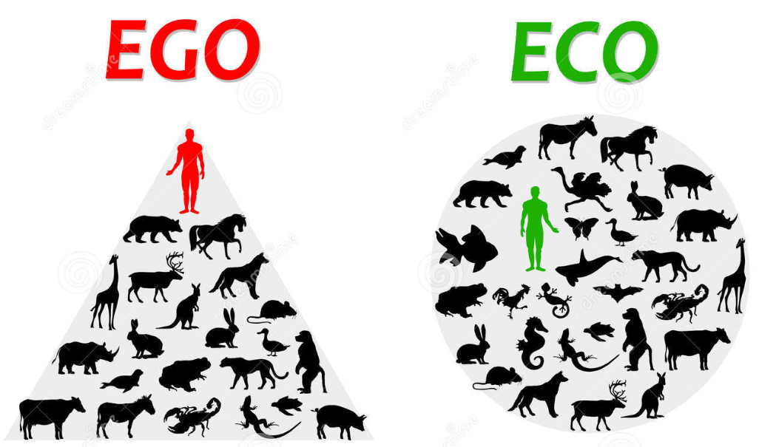
MARKET FAILURES & LIMITATIONS OF FREE MARKETS
TRAGEDY OF THE COMMONS
A situation where common goods are eventually depleted or destroyed due to conflicts between social interests and self interest.
KENNESAW STATE UNIVERSITY | COLES COLLEGE OF BUSINESS
Notes:
To understand this issue, we must first recognize that every good is characterized by a certain degree of “rivalness in consumption” and a certain degree of “excludability in consumption.”

Slide 60

MARKET FAILURES & LIMITATIONS OF FREE MARKETS
What is the Tragedy of the Commons?
(Video has Closed Captioned (CC) availability)
KENNESAW STATE UNIVERSITY | COLES COLLEGE OF BUSINESS

Slide 61
MARKET FAILURES & LIMITATIONS OF FREE MARKETS
Govt’s role in fixing
Tragedy of the Commons
Impose heavy fines and bans.
Limit fish catches or size of fishnets.
Establish property rights.
- charge a toll to use a freeway;
- implementing a tax for dumping wastewater.
KENNESAW STATE UNIVERSITY | COLES COLLEGE OF BUSINESS

Slide 62
MARKET FAILURES & LIMITATIONS OF FREE MARKETS
4. Market provision of goods that generate EXTERNALITIES
Some activities result in benefits or costs for individuals who are not “directly involved in the activity” (“external effect”).
FYI: We shall discuss more of this in Ch. 11 as we cover Government Failure.
KENNESAW STATE UNIVERSITY | COLES COLLEGE OF BUSINESS
Notes:
To understand this issue, we must first recognize that every good is characterized by a certain degree of “rivalness in consumption” and a certain degree of “excludability in consumption.”

Slide 63


MARKET FAILURES & LIMITATIONS OF FREE MARKETS
External Cost or Negative Externality
Cost of an activity borne by someone not engaging in the activity.
Free markets provide more than the optimal amount. (i.e., too much – [e.g., pollution, or noise from aircraft]).
External Benefit or Positive Externality
Benefit from an activity realized by someone not engaging in the activity.
Free markets provide less than the optimal amount. (i.e., not enough – [e.g., vaccines, installation of smoke detector in an apartment/house.]).
KENNESAW STATE UNIVERSITY | COLES COLLEGE OF BUSINESS

Slide 64
MARKET FAILURES & LIMITATIONS OF FREE MARKETS
In the presence of a “negative externality,” the free market would
provide more than the efficient amount of the good.
provide less than the efficient amount of the good.
have trade take place at a price of $0.
None of the above answers are correct.
ANSWER: A
KENNESAW STATE UNIVERSITY | COLES COLLEGE OF BUSINESS

Slide 65
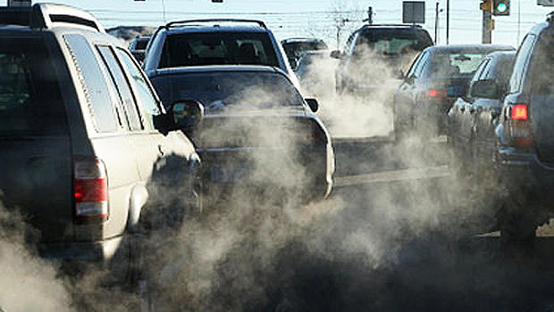
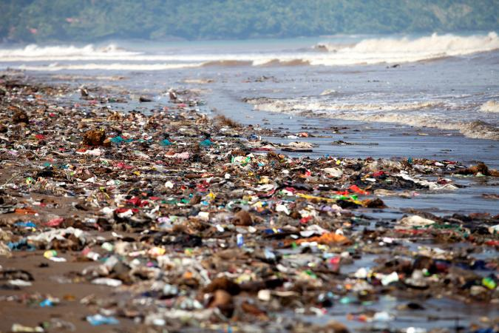
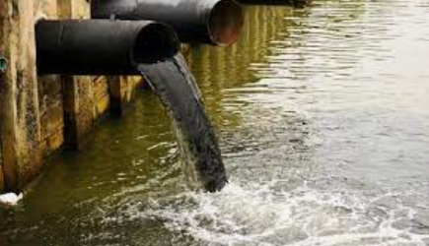
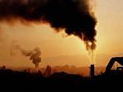
MARKET FAILURES & LIMITATIONS OF FREE MARKETS
WHAT IS THE “OPTIMUM” AMOUNT OF POLLUTION IN SOCIETY?
Tempting to answer, “none or zero pollution is optimum.”
RECALL: Optimum level of Production & Consumption is “where Marginal Social Cost (MSC) = Marginal Social Benefit (MSB).”
Thus, if MSC = MSB, there are no negative externalities.
KENNESAW STATE UNIVERSITY | COLES COLLEGE OF BUSINESS
Notes:
Because pollution is something we would all like to see reduced to zero, the tempting answer may be “no pollution is optimum for society.” However, the correct economic answer is: “the level of pollution that occurs from activity in markets where marginal social cost = marginal social benefit.” (If MSC = MSB, then there are no negative externalities (SEE ANSWER ON NEXT SLIDE)

Slide 66
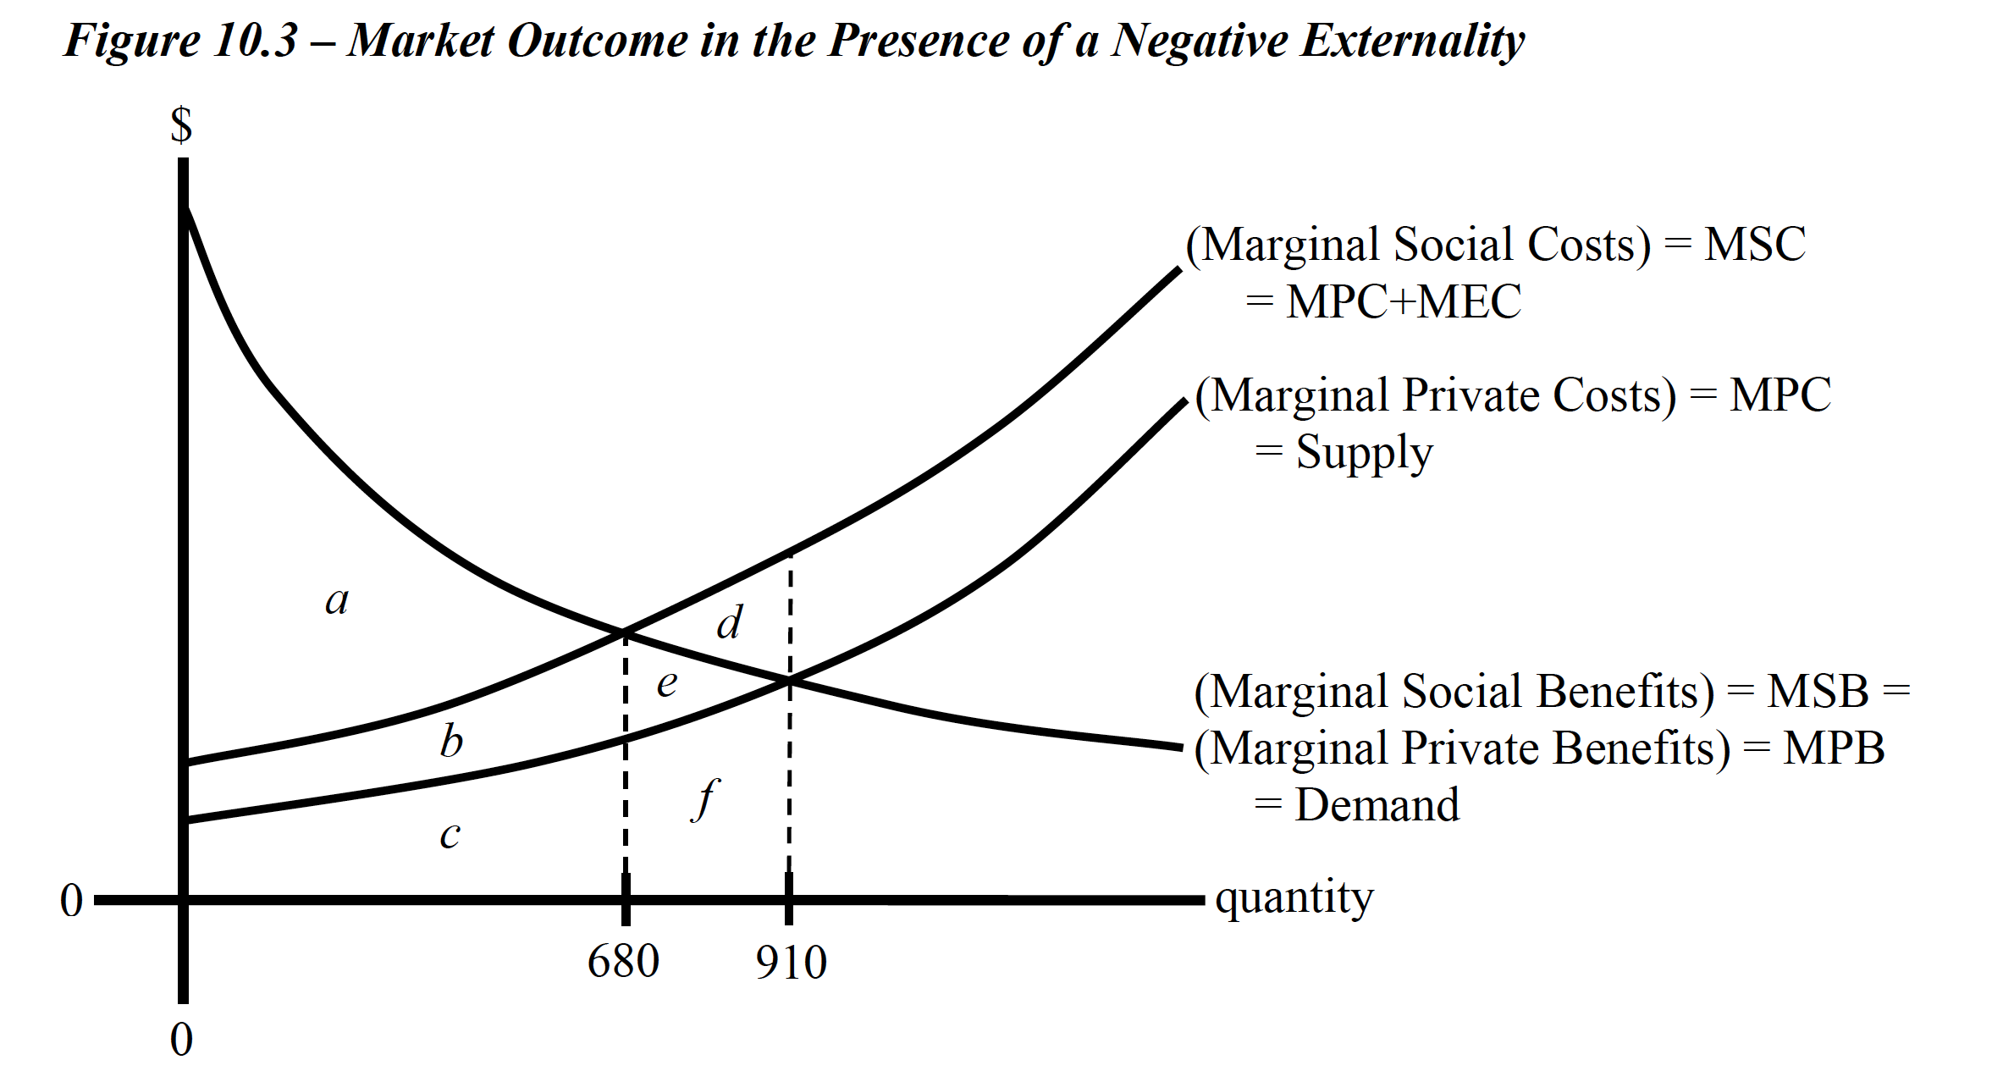
MARKET FAILURES & LIMITATIONS OF FREE MARKETS
Recall: buyers & sellers create the free market equilibrium by pursuing their self-interest.
Free mkt equilibrium, is indicated by the intersection of (MSB=D) & (MPC=S) with quantities of trade of 910 units.
Total Social Surplus is indicated by the intersection (MSB=MPB=D)
& (MSC=MPC) that is maximized at the optimum/efficient level of production/trade of 680.
Negative Externality is evident since the free-market equilibrium provides too much (910 vs 680) of a bad (e.g., pollution).
This inefficiency is called DWL & is represented by “area (d).”
Thus, a market economy, without any government regulation, will produce “too much” pollution.
KENNESAW STATE UNIVERSITY | COLES COLLEGE OF BUSINESS

Slide 67
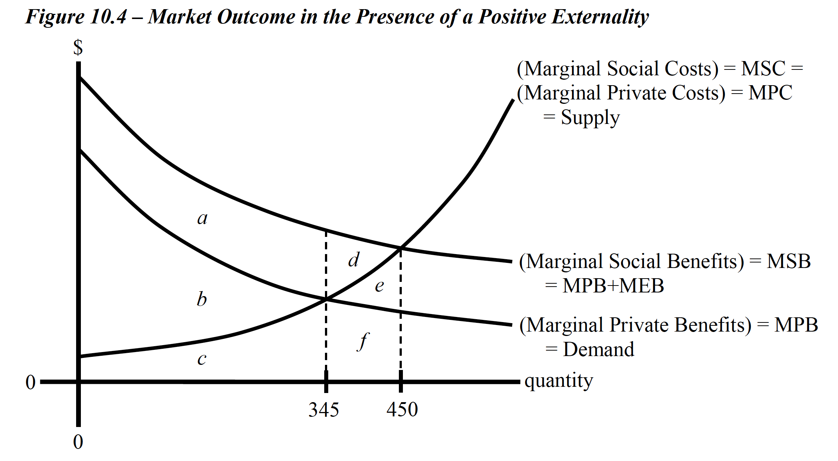
MARKET FAILURES & LIMITATIONS OF FREE MARKETS
Recall: buyers & sellers create the free market equilibrium by pursuing their self-interest.
Free-market equilibrium is indicated by the intersection of (MPB=D) & (MSC=MPC=S) with quantities of trade of 345 units.
Total Social Surplus
is indicated by the intersection of (MSB=MPB) & (MSC=MPC=S), that is maximized at the optimum/efficient level of production/trade of 450.
Positive Externality is evident since the free-market equilibrium provides too little (345 vs 450) of good thing (e.g., vaccination).
This inefficiency is DWL & is represented by “area (d).”
Thus, a market economy, without any government regulation, will produce “too little” batches of vaccines.
KENNESAW STATE UNIVERSITY | COLES COLLEGE OF BUSINESS

Slide 68
MARKET FAILURES & LIMITATIONS OF FREE MARKETS
COASIAN SOLUTION TO EXTERNALITIES
clearly and fully define property rights.
individuals must pay compensation if they infringe upon the property rights of others.
allow parties to negotiate with one another to reach an efficient outcome.
2 Examples:
Two property owners on a mountainside negotiate a compensation for the damage caused by water runoff from the higher land to the lower land.
Two neighbors with adjacent properties agree on a payment for the benefit of planting pear trees that provide shade and fruit to both parties.
KENNESAW STATE UNIVERSITY | COLES COLLEGE OF BUSINESS

Slide 69
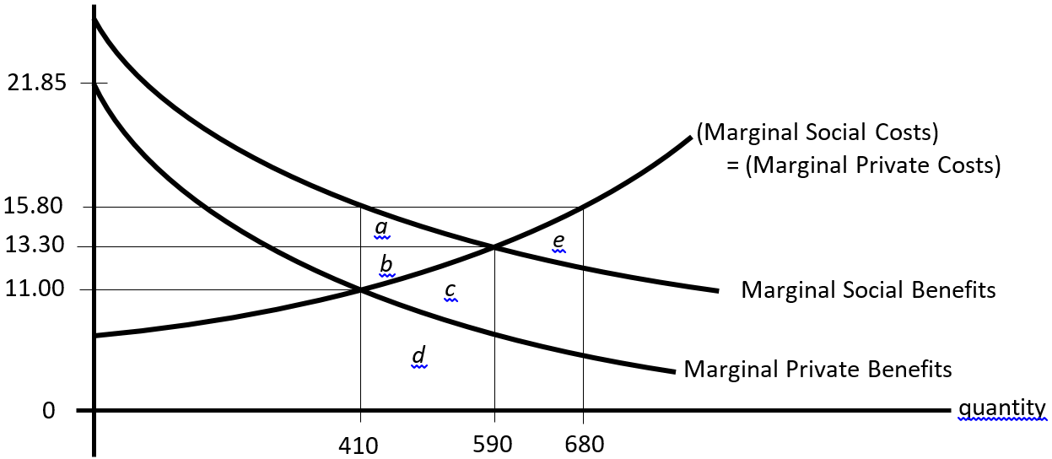
MARKET FAILURES & LIMITATIONS OF FREE MARKETS
Consider a good with Marginal Private Benefits, Marginal Private Costs, Marginal Social Benefits, and Marginal Social Costs as illustrated below.
At the free market outcome (without any government intervention) there would be a Deadweight-Loss equal to _______, if production were at 410.
“area c.”
“area e.”
“areas a+b.”
“areas a+b+c+d.”
KENNESAW STATE UNIVERSITY | COLES COLLEGE OF BUSINESS

Slide 70

Brockovich, a single mother with no formal education, few prospects for employment, and down on her luck, gets a job as a file clerk for a small law firm.
Spurred on by her efforts at uncovering the truth, the law firm she works for becomes involved in one of the largest class action lawsuits in history, resulting in a settlement of over 300 million dollars!
Ed Masry (Albert Finney) and Erin
Brockovich meet with a representative
of Pacific Gas & Electric to discuss a
settlement offer from the firm.
The Co. offer compensates the
claimants for the value of the land
they own, but no compensation is offered for medical damages because of toxic poisoning.
What type of externality are we experiencing is this clip?
ERIN BROCKOVICH -A Lame-Ass Offer
(Video has Closed Captioned (CC) availability)

Slide 71
MARKET FAILURES & LIMITATIONS OF FREE MARKETS
5. Asymmetric/Unequal Information
(leads to Adverse Selection)
Types of decisions regarding transactions where a party is well informed compared to another.
E.g., Real estate market: It is the previous homeowner & the real estate agent who knows the most about the house/property in question..
KENNESAW STATE UNIVERSITY | COLES COLLEGE OF BUSINESS
Notes:
See pg. 246-248.

Slide 72




MARKET FAILURES & LIMITATIONS OF FREE MARKETS
IF PARTIES ARE NOT WELL INFORMED, IS THERE A ROLE FOR GOVERNMENT?
Yes, its justified. If consumers must incur substantial costs to become more informed about product quality.”
OSHA
FDA
EPA
EXAMPLES OF GOVERNMENT REGULATING PRODUCT QUALITY?
KENNESAW STATE UNIVERSITY | COLES COLLEGE OF BUSINESS
Notes:
“Having the government play a role in regulating product quality is more easily justified if consumers would have to incur substantial costs to become informed enough to even make an assessment of product quality.” (pg. 247).

Slide 73
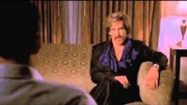
Does Asymmetric/Unequal Information Exist in this Clip?
(Video has Closed Captioned (CC) availability)
An event is considered common knowledge among a group of agents when each player knows the information, each player knows that the other one knows it, etc.
Common knowledge is the limit of a potentially infinite chain of reasoning about knowledge.
In this scene from Dodgeball, White Goodman Stiller) is trying to assert that common knowledge exists between
himself and Pete LaFleur (Vince Vaughn).

Slide 74
MARKET FAILURES & LIMITATIONS OF FREE MARKETS
SUMMRY OF WAYS GOVERNMENT CAN ATTEMPT TO CORRECT MARKET FILURES:
Preventing monopoly formation.
Providing/protecting public goods.
Regulating through government intervention.
Taxing/subsidizing market participants to avoid negative externalities.
Undoing asymmetry of information among buyers and sellers
KENNESAW STATE UNIVERSITY | COLES COLLEGE OF BUSINESS

Slide 75
Some slides were generated created by Daniel Forsberg
MARKET FAILURE
Notes:
End of slides.

